Slide 1
HackRush ‘24: Volatility Forecasting Challenge
Quantitative Finance
Samyak Gosalia (22110086)
Farhan Obaid (2211081)

Slide 2
Problem Statement
Volatility forecasting is crucial for managing risk and crafting successful trading strategies in financial markets. Accurate predictions empower investors and traders to optimize portfolios and make informed decisions, mitigating potential risks.
We have created a trading strategy that utilizes volatility predictions for select stocks on the National Stock Exchange (NSE) of India. The goal was to develop a robust forecasting model and implement a strategy that maximizes returns based on these predictions.

Slide 3
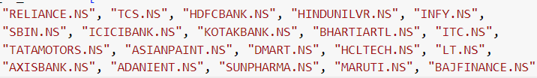
NSE Top 20 Stocks
We will be testing our trading strategies and forecasting volatility on the NSE's top 20 stocks, determined by market capitalization.

Slide 4
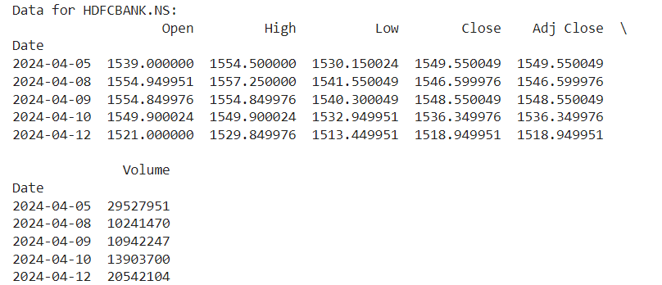
Dataset from Yahoo Finance

Slide 5
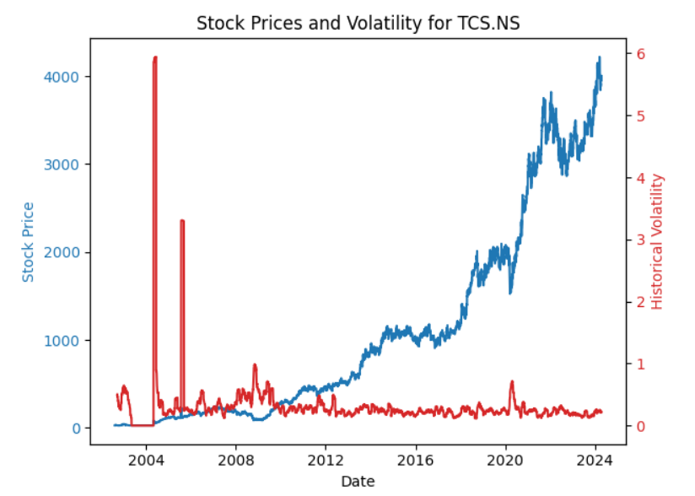
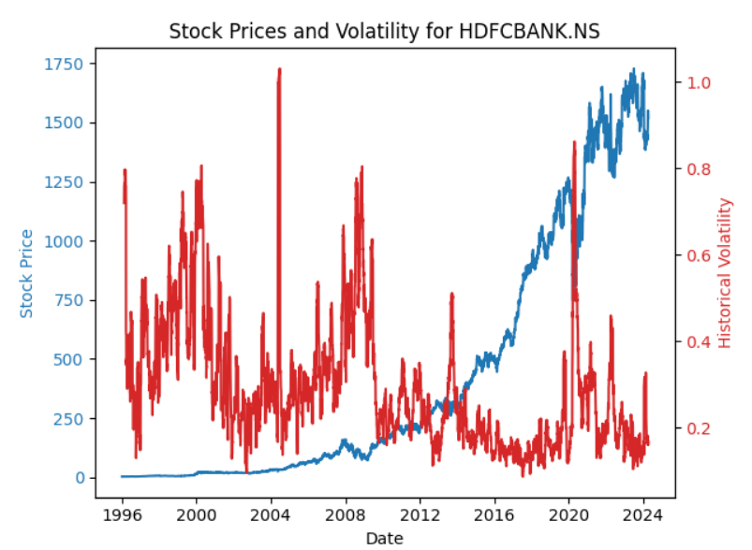
Volatility Comparison

Slide 6
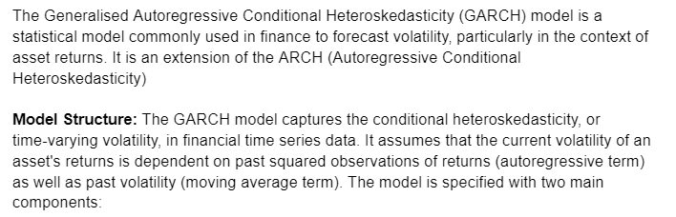
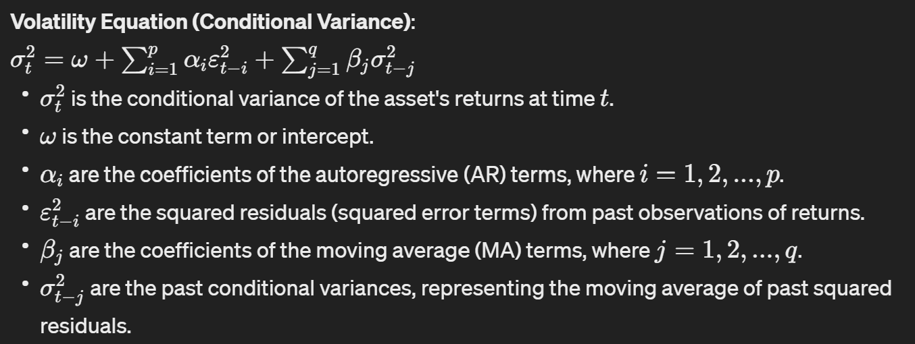
GARCH Model for Volatility Forecasting

Slide 7
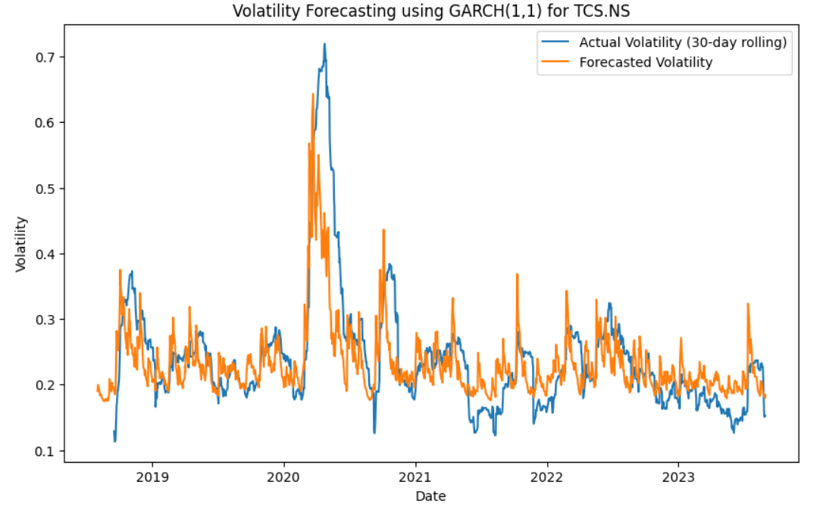
Forecasted Volatility vs Actual Volatility ( 30 days rolling)

Slide 8
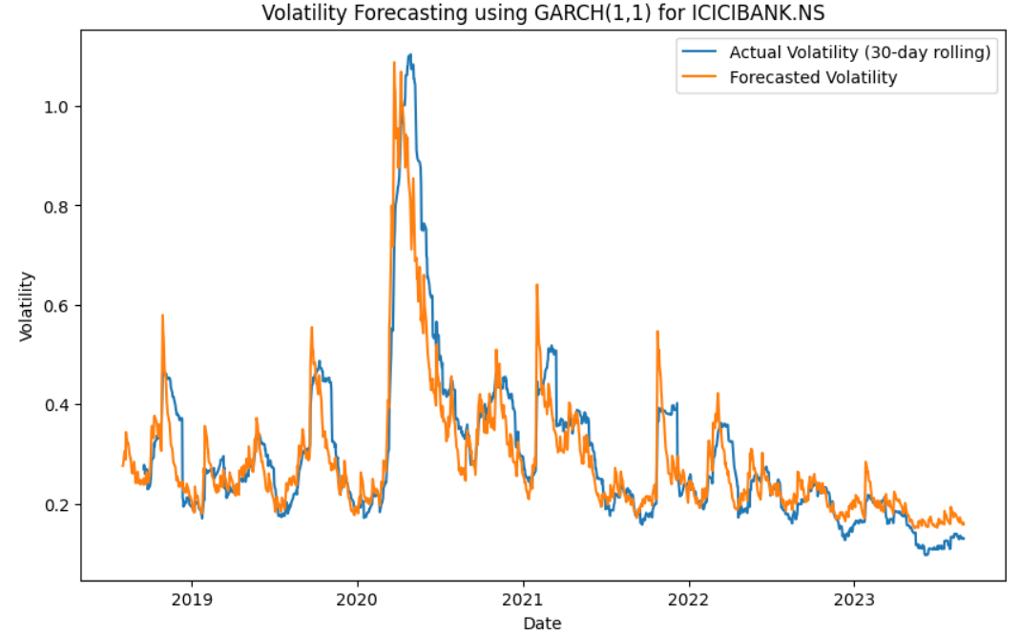
Forecasted Volatility vs Actual Volatility ( 30 days rolling)

Slide 9
Hypothesis for Trading Strategy
We hypothesize that trading based on forecasted volatility and current market trends will yield profitable outcomes. Specifically, we will initiate trades when the forecasted volatility for the next data point exceeds the volatility of the current data point. The decision to take a buy (long) or sell (short) position will be determined by the prevailing market trend. We will take buy (long) for bullish market trend and sell (short) position for bearish market trend.

Slide 10
Hypothesis for Trading Strategy
We define a bullish market trend as a scenario where the price of the stock increases for a continuous period of at least five days, allowing for occasional minor decreases (not exceeding 1%) within this period. Similarly, a bearish market trend will be identified when the price decreases continuously for five days, with occasional minor increases permitted. We anticipate that this strategy will enable us to capitalize on changes in volatility while aligning with the prevailing market sentiment, leading to profitable trading opportunities.

Slide 11
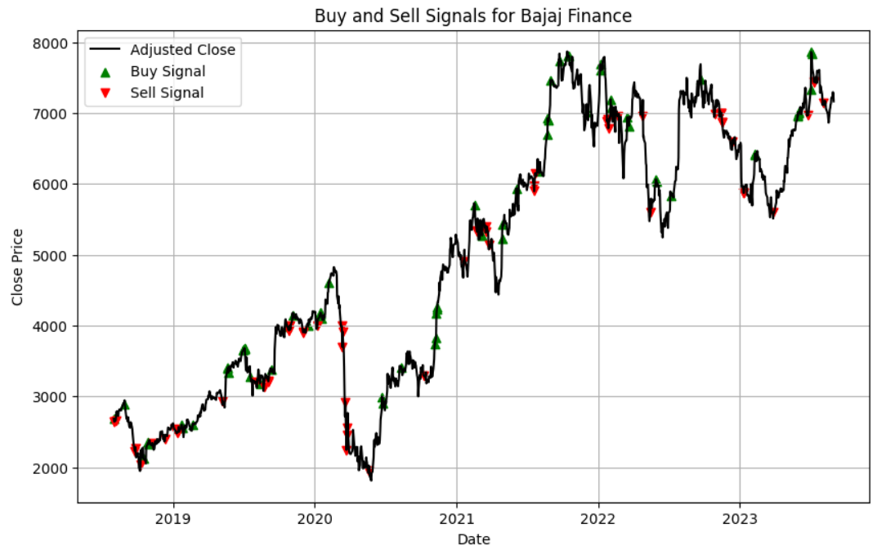
Buy and Sell Signal

Slide 12
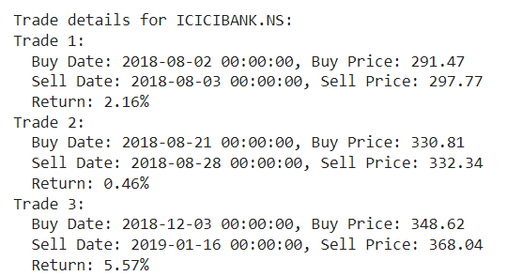
Trade Details

Slide 13
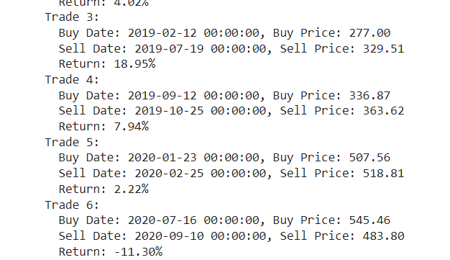
Trade Details

Slide 14
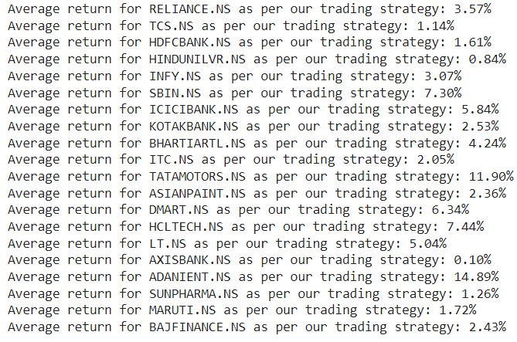
Average Returns for all trades

Slide 15
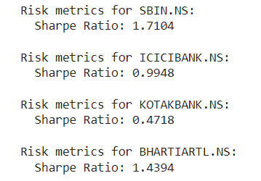
Risk Management through Sharpe Ratio

Slide 16
Future Improvements
Advanced Trading Strategies:
Integrate additional indicators such as MACD, RSI, etc for better trading strategies.
Experiment with diverse methods and risk management strategies to optimize trading performance.
Machine Learning for Volatility Forecasting:
Use advanced ML like LSTM for better volatility forecasts.
Explore ML techniques to optimize GARCH model.
Incorporate deep learning for precise forecasts.

